Slide 15
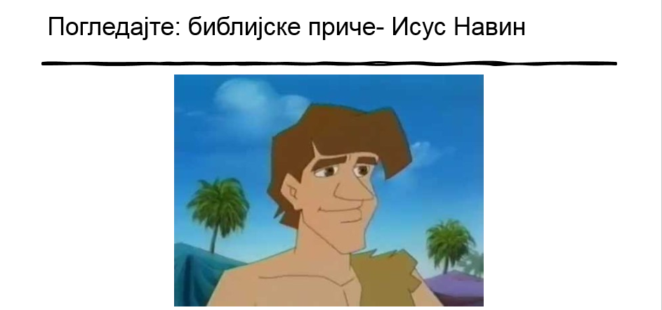
https://www.youtube.com/watch?v=8fC-OoT_Um0

